Slide 1
Institute of International Relations of
Taras Shevchenko National University of Kyiv
Economic and Environmental Committee meeting
Growing risks to security from environmental threats
and damage to critical energy infrastructure
27 April 2022, Vienna
Svitlana Andrushchenko, Assosiate Professor, Ph.D.

Slide 2
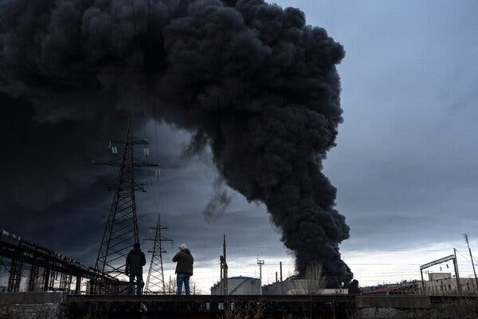
Dirty War of Russia
Dirty, brutal war of Russia against Ukraine.
Aggressive invasion, genocide, killings, torturing, raping civil population –
genocide and environmental degradation as a part of it – ecocide.
Civil targets as the main target of the Russian hostilities in Ukraine.
To destroy industrial and developmental potential of Ukraine.
Ukraine is replete with chemical plants and storage facilities, oil depots,
coal mines, gas lines and other industrial sites,
which could release enormous amounts of pollution if damaged. Multiple has been already hit!

Slide 3
Dirty War of Russia
Why Environment matters while it considered to be secondary issue during conflicts:
pollution of air, water, lands, fires, deforestation, destruction of eco systems – respiratory system as coronavirus crisis demonstrated matters, cardiovascular illness;
economic destruction (45% of Ukraine’s GDP, 75% of industry), secondary – overstress on European countries (displaced persons), transboundary effects.
Reports from the ground, and research on previous armed conflicts, suggest that the ecological impact of the conflict could be profound. Wars destroy habitats, kill wildlife, generate pollution and remake ecosystems entirely, with consequences that ripple through the decades.
Russian troops have already entered, or conducted military operations in, more than one-third of the nation’s protected natural areas, their ecosystems and species are vulnerable.
The long-term environmental impacts of war: wars often cause economic and food insecurity, social instability, institutional responds.

Slide 4
Dirty war of Russia
Lessons learned / Environment risks and opportunities
DURING the war and POST-WAR recovery.
Lessons learned | Risks and challenges | Opportunities/avenues for OSCE/ ideas
The focus on the new model of OSCE security on new principles of prevention of wars and genocides ever, possible consequences for aggressor and abuser, incorporation of the green standards and requirements of development. The war in Ukraine as case for Russia attempting to position itself geopolitically express readiness to use massive destruction weapon / nuclear / chemical / biological with total environmental damage of transboundary / globally targeted effects. = Huge impact on the total global environment. Comprehensive security OSCE approach faces ineffectiveness and the need for refocusing on prevention, rapid monitoring and responsibility for environmental security concept within OSCE region. | Political will Readiness and ability of all participating state – Russia, namely, to fully implement new principles, share responsibilities. | Search for the new role and place of Organization in new security environment. Green security / environmentalization of military security For example, green taxonomy (environmental requirements incorporated into economic activity), we need a concept of so-called green security / environmentalization of military security (correlation between military and environment, standards in equipment, role of military in environmental disasters, on site fixing of environmental crimes, energy supply for military and impact on local population, defence and ecology etc.)

Slide 5
Dirty war of Russia
Lessons learned | Risks and challenges | Opportunities/avenues for OSCE/ ideas
At environmental level war and hostilities have resulted huge environmental degradation of land, air, water. Cases: Environmental assessment and recovery priorities for Eastern Ukraine, OCSE financed project, 2017 https://www.osce.org/files/f/documents/4/3/362566_0.pdf Environment of Crimea: changes and losses upon Russia`s occupation” Part І. Destruction of wild nature, 2021 https://krymsos.com/doslidzhennya-dovkillya-krymu-zminy-i-vtraty-za-chas-okupacziyi-chastyna-i-znyshhennya-dykoyi-pryrody/ Environment of Crimea: changes and losses upon Russia`s occupation” Part ІI. Pollution of environment and exhaustion of natural resources, 2021 https://krymsos.com/doslidzhennya-dovkillya-krymu-zminy-i-vtraty-za-chas-okupacziyi-chastyna-ii-zabrudnennya-dovkillya-ta-vysnazhennya-pryrodnyh-resursiv/ Environmental deterioration of the Black Sea and Sea of Azov areas upon Russia`s annexation of Crimea, 2022, Center for Defense Strategies. https://defence.org.ua/gallery/crimea-platform-research-series-contd-krymska-platforma-seriia-doslidzhen-prodovzhennia/ Emily Enthes. A ‘Silent Victim’: How Nature becomes a Casualty of War: Research on past conflicts suggests that the war in Ukraine could have a profound environmental impact. https://www.nytimes.com/2022/04/13/science/war-environmental-impact-ukraine.html | Issue of responsibility for environmental crimes, international environmental law, evidences for contributions and environmental reparations. Russia as user of prohibited weapons (phosphorus and cassette shelling, biological, chemical, nuclear weapon); Access to the military actions and battlefields for probes and evidences collections. Ministry of environmental protection and natural resources of Ukraine data base collection of environmental crimes https://mepr.gov.ua/news/39125.html | Recharging of the OSCE institutional structure by incorporation of the so called ‘rapid reaction (co)missions’ during aggressive military actions on sites with a view on rapid fixation and collection of different types of military crimes including ecological, monitoring, environment risk and threats assessment. Methodology / technics and methods / accounting of environment losses and damages, environmental risks. !!! Unprecedented technological cooperation on collection of evidences as the bases for further cooperation on environmental issues – data base within wider OSCE area Individual criminal responsibility for environmental crimes, and OSCE as the basic institution to fix these crimes, not for those who make orders to target energy or other environmental hazardous objects, civilian energy and water supply infrastructure to hide by state responsibility and military conditionality

Slide 6
Dirty war of Russia
Lessons learned | Risks and challenges | Opportunities/avenues for OCSCE/ ideas
Russia targets energy infrastructure (power stations, nuclear power stations, oil refineries, gas pipelines, waste storages, chemical wastes storages, sewages etc). Climate change targets, GHG Emissions Weapons spew toxic gases and particulates into the air and leak heavy metals into soil and water. Ecocide as an intended destruction of the environment and ecosystems which causes losses and damages for all humans. Examples of ecocide during wartime include the impacts of nuclear explosions, pollution, and deforestation. | Nuclear power station and Russia`s nuclear terrorism Climate change targets and emissions resulted by the military actions and hostilities, destruction of buildings, infrastructure, energy equipment. Militarisation of Arctic and Black Sea by Russia since illegal Crimea occupation in 2014: maritime biodiversity, restriction for littoral states to develop recreational and energy potential, mining of the maritime area + Black Sea basin rivers (fisheries, transportation routs), pollution. | No Fly Zone over NPS!!! Ecocide and national law Multiple risks for climate change targets but follow the implementation of this targets. Overall effect of the Russian invasion into Ukraine on Green transformation and climate change policy targets of all European states. Opportunities / push for changes in energy systems / restructuring energy systems, fossil fuels diminishing role, energy supply balancing equipment, new technological cycles etc.

Slide 7
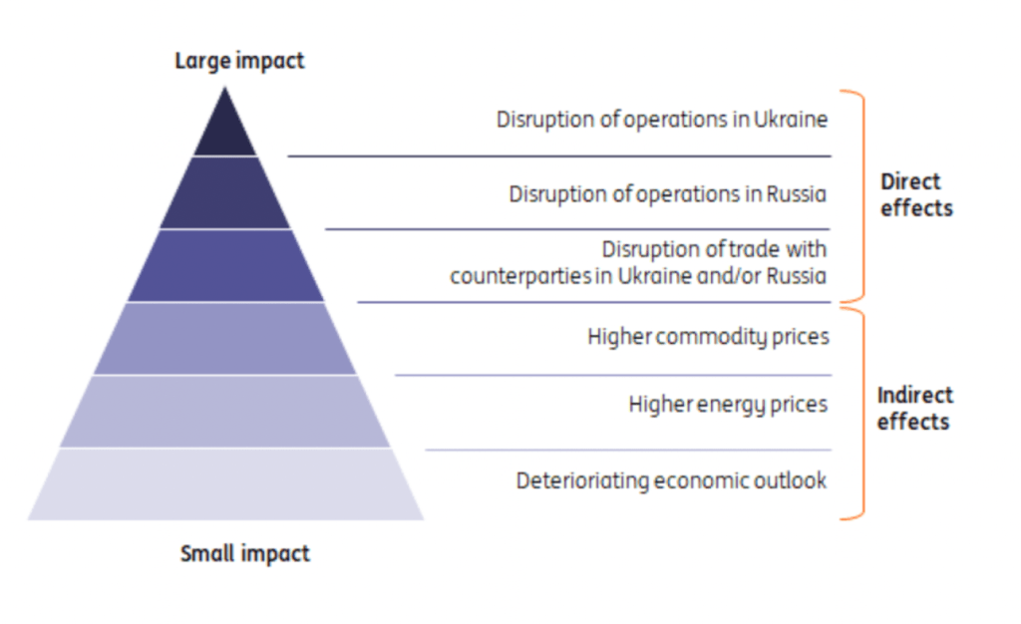
Dirty war of Russia
Lessons learned | Risks and challenges | Opportunities/avenues for OSCE/ ideas
Land degradation / Agriculture / Food security within the OSCE area and wider War in Ukraine and Global Agriculture in 2022 Report, Robert Lansing Institute, March 2022. https://lansinginstitute.org/2022/03/25/war-in-ukraine-and-global-agriculture-in-2022/?fbclid=IwAR0QGrAfwOsibA4t90qvNzpmJFGv9jlJpODZqKqH08br0zDCRnFHw9to_Tg | Changes in food supply in OSCE participating states: trade, higher prices, inflation growth, logistic, supply chain, energy prices. Political destabilisation in Middle East and North Africa, as a cause for new wave of migration into Europe. | Study and research of ecology-economic potential of the ecosystem services, classification of lands, water resources for ecosystem services, consequences and scenarios for OSCE region on the basis of open cooperative dialogue among state-business-NGOs-research institutions, new jobs! new approaches to education and professional skills.

Slide 8
Dirty war of Russia
Lessons learned | Risks and challenges | Opportunities/avenues for OSCE/ ideas
Overstress on Ukraine`s neighbouring states causes by displacement of people: water stress, food security, energy consumption and supply, job opportunities, trainings and retraining etc. | Degradation and overstress on natural resources and economic assets of OSCE participating states | Development of the new model of economic development with functional incorporation of green development and eco-friendly principles; Ukraine as a part of European energy system: new technologies and equipment for energy supply balancing, digitalization and education.

Slide 9
Dirty war of Russia
Lessons learned | Risks and challenges | Opportunities/avenues for OCSE/ ideas
Recovery and environmental restoration | Finances and approaches that could be applied | Models of recoveries of Ukrainian economy as a contributor to the OSCE security, cases of clean up and environmental restorations (South Korean, as an example); repayments of Russia for restoration of the destroyed areas by hostilities as a part of peace agreement: Green Marshal plan: green transit, decarbonization, decentralization, social and environment responsibility etc.

Slide 10
THANK YOU FOR
YOUR ATTENTION

