Slide 1
Public Diplomacy: A Primer

Slide 2
John Brown PhD Princeton 1977 Russian History Foreign Service Officer 1981-2003

Slide 3
Brown’s Letter of Resignation (To Secretary of State Colin Powell)

Slide 5
Congressional Research Service Definition

Slide 7
First uses of the Term “Public Diplomacy”

Slide 8
And further…

Slide 9
Edmund Gullion NATO SACEUR Ambassador to Congo Dean, Fletcher School of Law and Diplomacy

Slide 10
Gullion on “Public Diplomacy” 1965

Slide 11
Public Diplomacy in the United States

Slide 12
Walter Lippmann 1889-1974 Public Opinion 1922 “the Great, blooming, buzzing confusion of the outer world” “the picture in our heads” “We do not first see. We define first and then see.” (“top down”: elites provide guidance)

Slide 13
John Dewey 1859-1952 “participators,” not “spectators” (“bottom-up”) “truth” comes from citizens exchanging opinions through conversation

Slide 14
Nicholas Cull

Slide 15
National Security Act, 1948

Slide 16
President Dwight D Eisenhower

Slide 17
Eisenhower’s “P factor” (psychology)

Slide 18
(1961 President John F. Kennedy) Edward R Murrow USIA Director 1961-1964

Slide 20
1961 Mutual Educational and Cultural Exchange Act

Slide 21
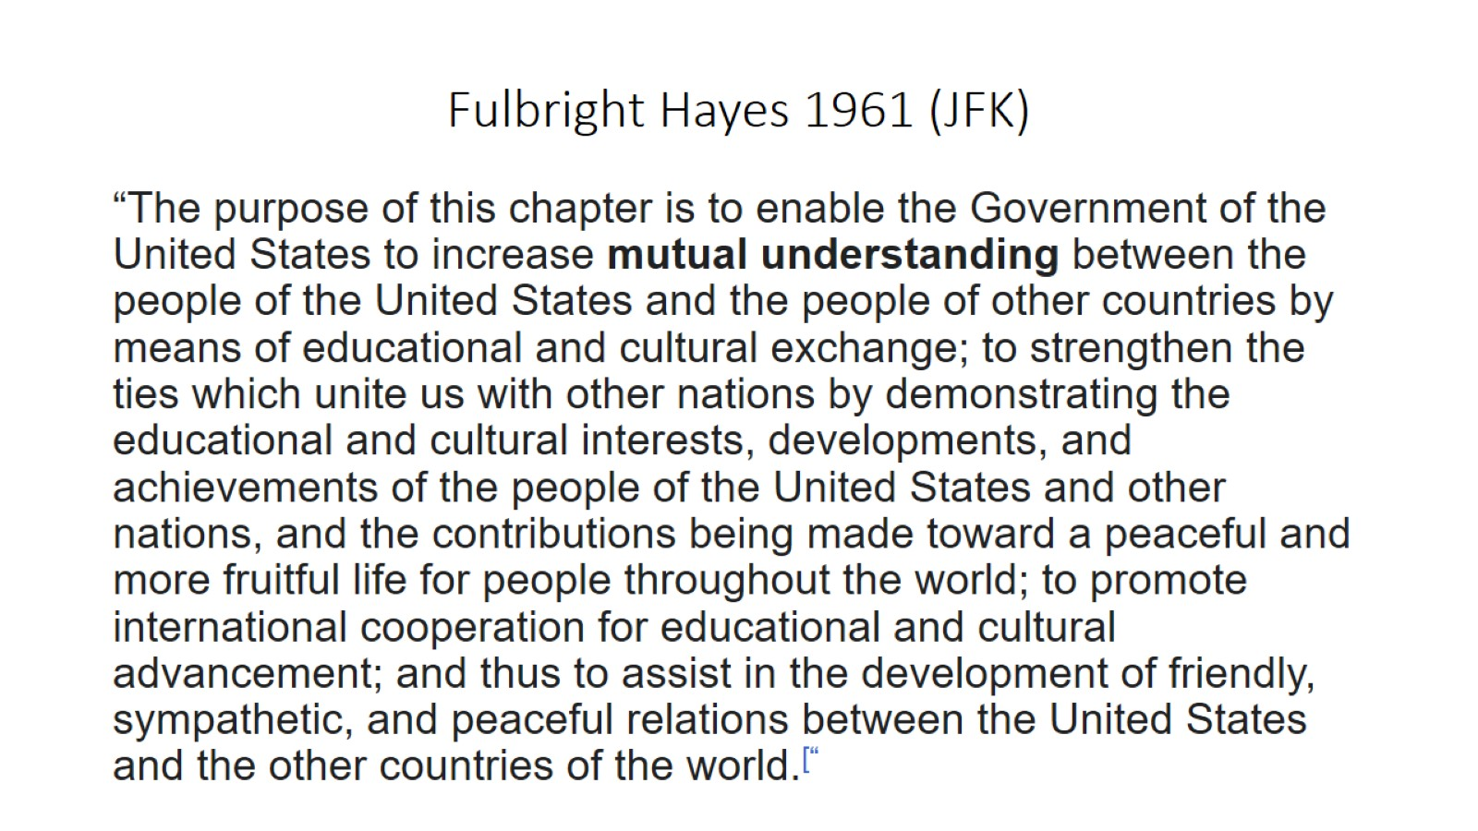
Fulbright Hayes 1961 (JFK)

Slide 22
Jimmy Carter “USICA”

Slide 23
USIA Director Charles Z Wick 1981-89 “Bedtime for Bonzo”

Slide 24
Wick’s USIA budget $458 million in 1981, $820 million in 1988 WORLDNET 1983+ Solidarity, Grenada, “Let Poland be Poland”

Slide 25
President Ronald Reagan 1981-89

Slide 26
President George H.W. Bush 1989-93

Slide 27
Thatcher, INF, Oslo, Madrid, Berlin Wall

Slide 28
Clinton, “Peace Dividend”

Slide 29
President George W Bush 2001-09

Slide 30
Караван проходит, собака лает

Slide 31
And What Remains?

Slide 32
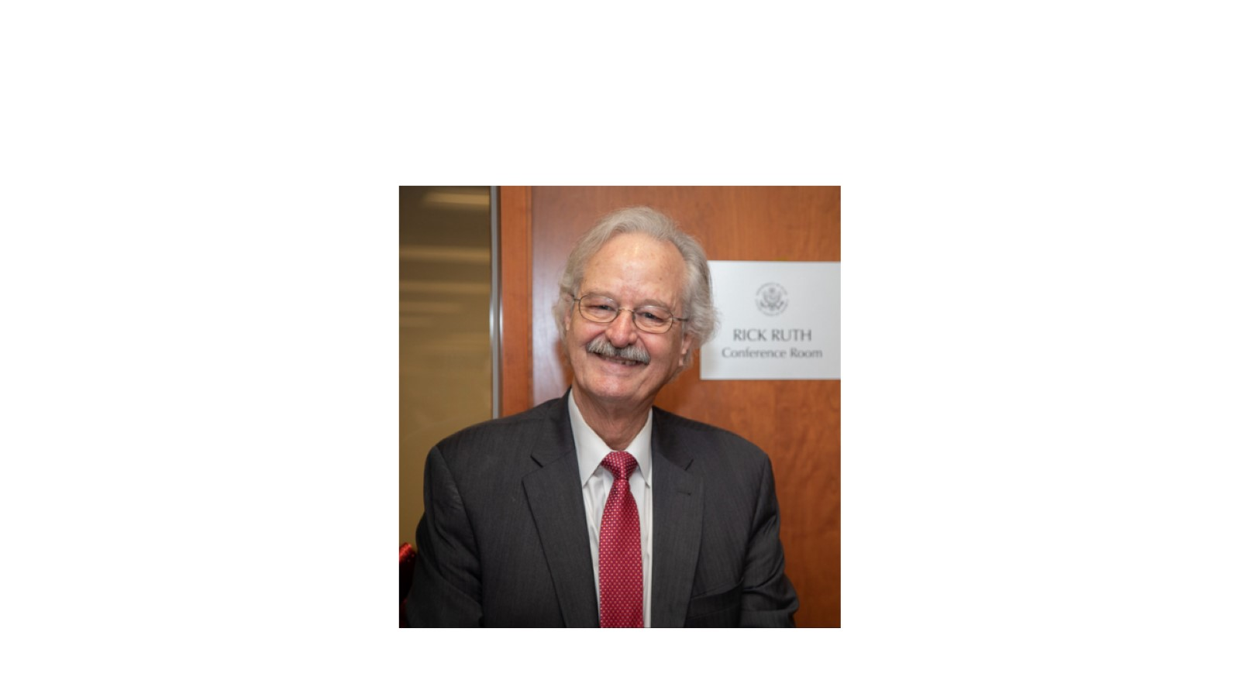

Slide 33
Steve Thibeault, Baghdad 1990 (“un functionario de la Embajada norteamericana en Bagdad sonrie ante un grupo de mujeres iraquies que exigian ayer el levantamentinto del embargo”)

Slide 34
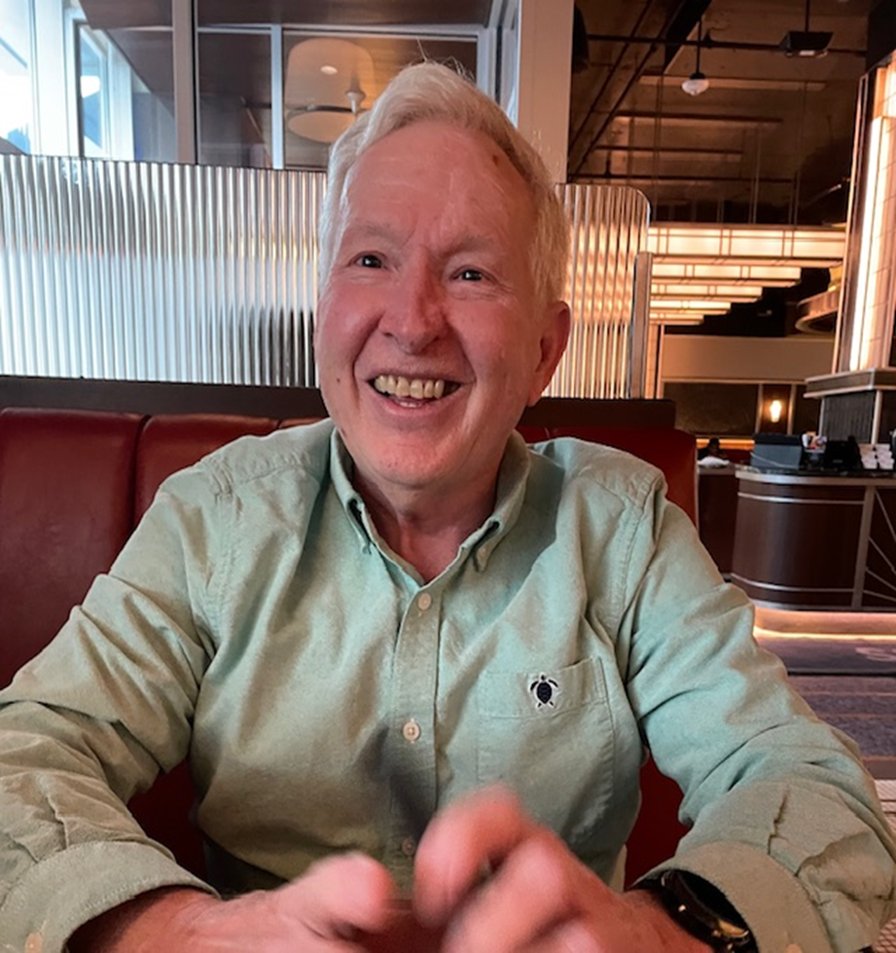
And thirty+ years later – February 12, 2024…

Slide 35
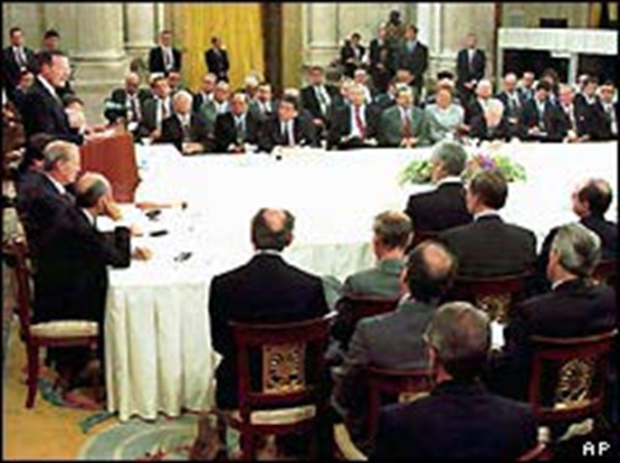
Madrid Middle East Peace Conference 10/31/91

